Slide 1
Look at M.E.
The new museum experience

Slide 2
Design

Slide 3
1
Personas
2
The Storyboards
CONTENTS
3
Design Conclusions

Slide 4
1
Personas

Slide 5
Personas

Slide 6
Personas

Slide 7
Personas

Slide 8
2
The Storyboards

Slide 9
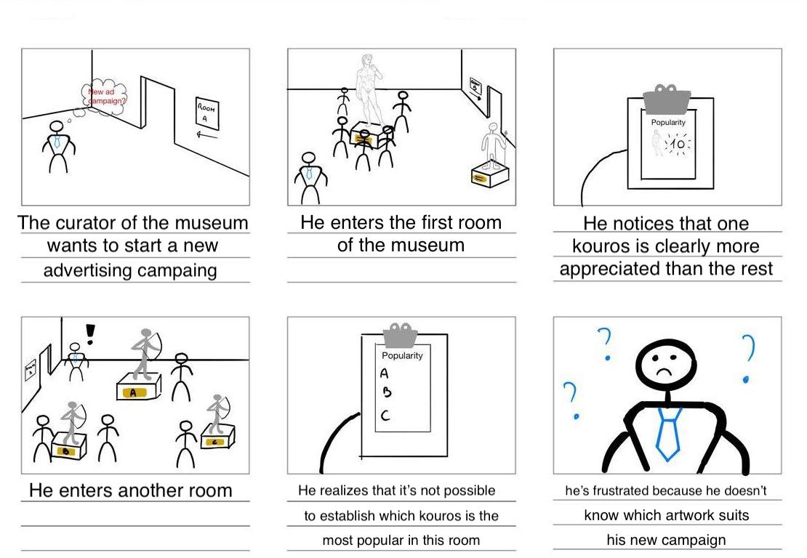
First Storyboard – The Problem
The Storyboards

Slide 10
First Storyboard – The Solution
The Storyboards

Slide 11
Second Storyboard – The Problem
The Storyboards

Slide 12
Second Storyboard – The Solution
The Storyboards

Slide 13
3
Design Conclusions

Slide 14
Goals to Be Achieved
Design Conclusions
Improving the overall museum experience, making it more suitable for inexpert visitors.
Providing an automatic system for the museum, that collects data about the popularity of the pieces

Slide 15
Final Observation
Design Conclusions
Raising the interest in neglected artworks means raising the quality of the museum as well as of the entire user experience.

Slide 16
Evaluation

Slide 17
1
Needs analysis
2
Validity
Evaluation criteria
3
Surveys
4
Risk analysis

Slide 18
1
Need Analysis

Slide 19
Need Analysis
Overview
The idea of ​​the project comes from relevant needs of different users. What came out from our first survey is that many times museums are scattered, and the way they store work arts makes the experience difficult. To help museum curators and visitors of “Museo dell’Arte Classica - Sapienza” we created “Look at M.E.”.

Slide 20
2
Validity

Slide 21
Validity
After a careful analysis of the planimetry, we came to the conclusion that our project is feasible, in fact the implementation of boards with a proximity sensor can be done without any problems.
The museum, however, should provide speakers and lights capable of illuminating with a certain power the works of art involved in the experience.

Slide 22
3
Surveys

Slide 23
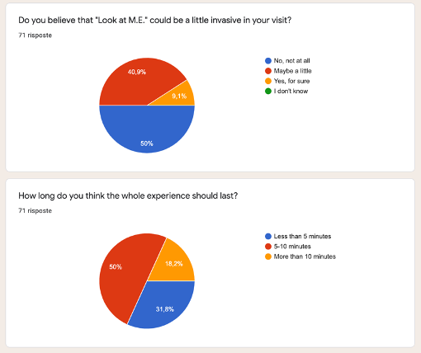
Surveys
We care about users
From the user point of view, what stands out from the survey is that the experience sometimes can be a little invasive, in fact we can see from the chart that the 40,9% of them believe that. Also, we can see that for several users the whole experience shouldn’t last longer than 10 minutes.
In the last question we asked a few suggestions to improve the experience: one that we found interesting is the implementation of a holographic presentation of the work of art. It is a nice idea; we will take in consideration during the second phase of development of our product.

Slide 24
4
Risk Analysis

Slide 25
Risk Analysis
The accuracy of the motion sensor is not bad at all, but it can happen that in difficult situations a measurement can be wrong.
Moreover, the proximity sensor cannot detect more than one person in its range, meaning that the popularity ranking can be biased if more visitors are near the work of art at the same time.
Regarding the lighting experience a latency problem might be on the activation from several sensors.
Despite that, the data provided by the product in most cases are reliable, so it can provide a comfortable user experience and reliable measurement to the museum curator.

Slide 26
Architecture

Slide 27
1
The system
2
The components
CONTENTS
3
The network
4
The output

Slide 28
1
The System

Slide 29

The System
Overview
Nome uses a B-L072Z-LRWAN1 board and several HC-SR04 proximity sensors to build a popularity table ranking the different art pieces while also triggering a guided tour for the visitor.
What do we need
The final product will need a system for every statue we want to make smart. It also need some platform and software implementations.

Slide 30
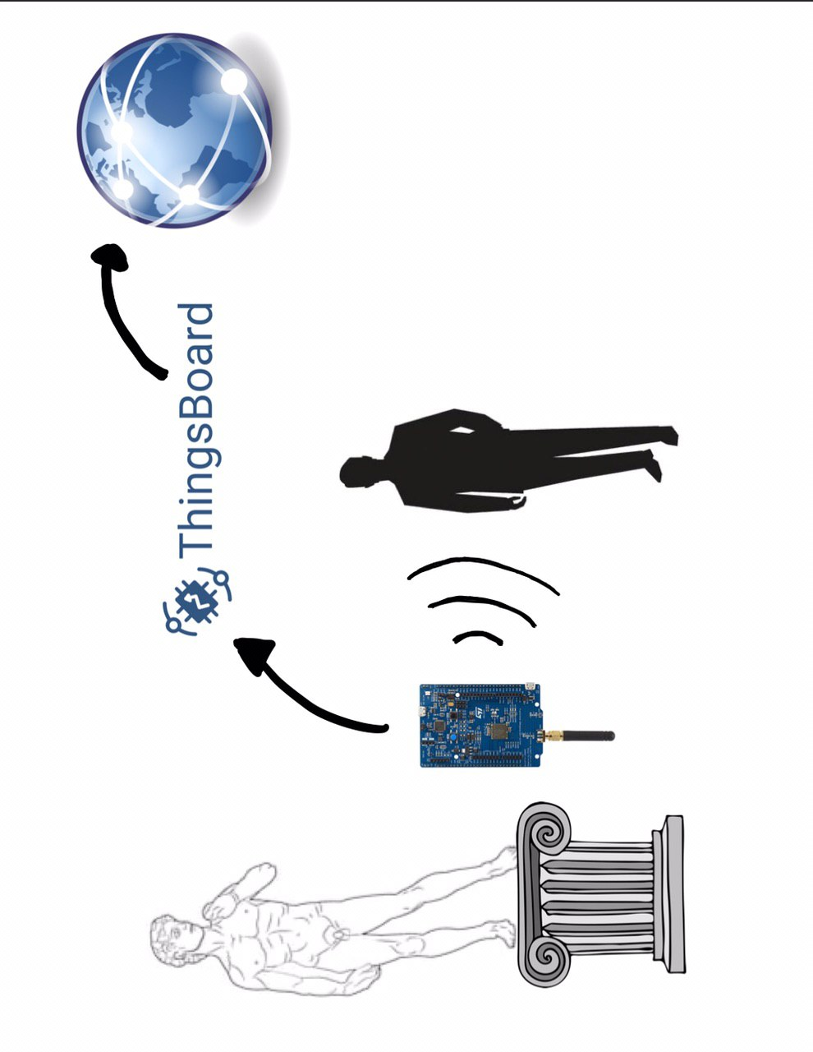
The System

Slide 31
2
The Components

Slide 32
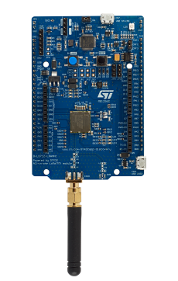
B-L072Z-LRWAN1 Board
The Components
The B-L072Z-LRWAN1 board is manufactured by STMicroelectronics and is pretty popular cause of its LoRa compatibility and its LoRaWAN class A certification.
Other main features are:
• 7 LEDs:
– 4 general-purpose LEDs
– 5 V power LED
– ST-LINK-communication LED
– Fault-power LED
• 1 user and 1 reset push-buttons
• Board power supply through the USB bus or external VIN/3.3 V supply voltage
or batteries
• 3 × AAA-type battery holder for standalone operation
• Support of a wide choice of IDEs
including IAR™, Keil®, GCC-based IDEs, Arm® Mbed™.

Slide 33
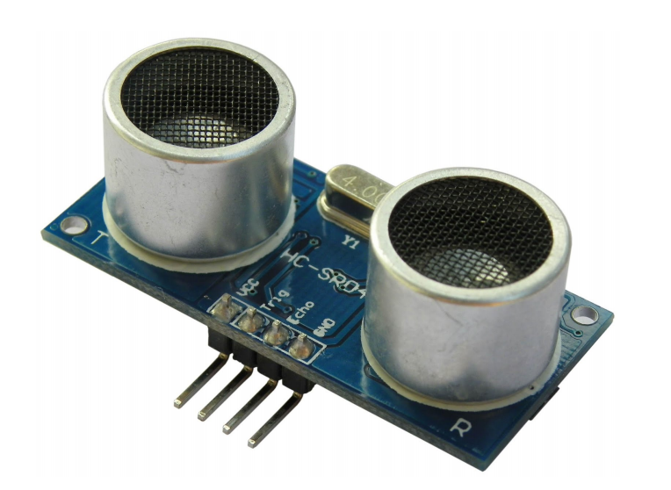
The HC-SR04 proximity sensor
The Components
The HC­SR04 ultrasonic sensor uses sonar to determine distance to an object like bats or dolphins do. It offers excellent non­contact range detection with high accuracy and stable readings in an easy­to­use package. It operates in a distance range going from 2cm to 400 cm.
The main features are :
● Power Supply :+5V DC
● Quiescent Current : <2mA
● Working Current: 15mA
● Effectual Angle: <15°
● Ranging Distance : 2cm – 400 cm
● Resolution : 0.3 cm
● Measuring Angle: 30 degree
● Trigger Input Pulse width: 10uS
● Dimension: 45mm x 20mm x 15mm

Slide 34
External Hardware
The Components
We also have some hardware external to our board, for example the light and sound system that our application will use depending on the values of some variables in our script. These are external since we are not implementing them in the board but must be connected to our broker in order to receive the values that trigger them.

Slide 35

Software Components
The Components
The implementation of the final product will need also several software components going from the OS in which we create our firmware to the cloud platform where we store our measurements:
Riot OS
PAHO Transparent Gateway
Mosquitto RSMB
Thingsboard

Slide 36
3
The Network

Slide 37
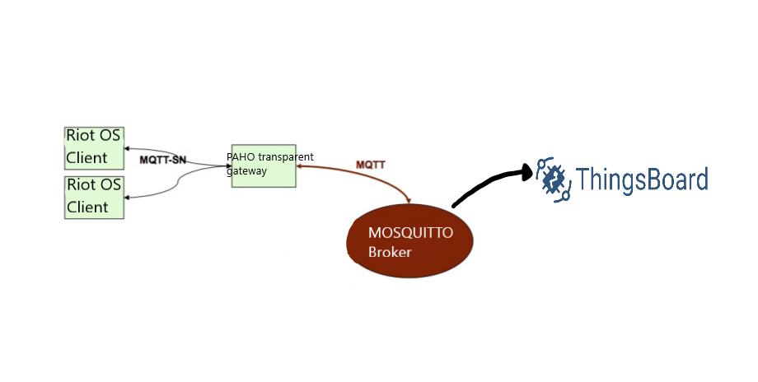
MQTT-SN
The Network
MQTT protocol is an open and lightweight publish/subscribe protocol designed specifically for machine-to-machine and mobile applications. It is optimized for communications over networks where bandwidth is at a premium or where the network connection could be intermittent. However MQTT requires an underlying network and this is too complex for very simple and low-cost devices such as wireless SAs.
MQTT-SN can be considered as a version of MQTT which is adapted to the peculiarities of a wireless communication environment. In fact it is designed to be as close as possible to MQTT, but is adapted to the peculiarities of a wireless communication environment such as low bandwidth, high link failures, short message length, etc.

Slide 38
4
The Output

Slide 39
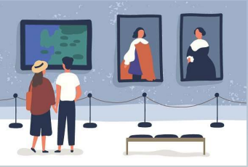
For the visitors
The Output
Our product offers two different type of outputs; one aimed to the museum visitors and one for the museum curator.
For the visitors in fact on activation a guided tour made by light that sequentally light up all the statues in the room and audio output to give visitors additional informations on the art pieces.

Slide 40
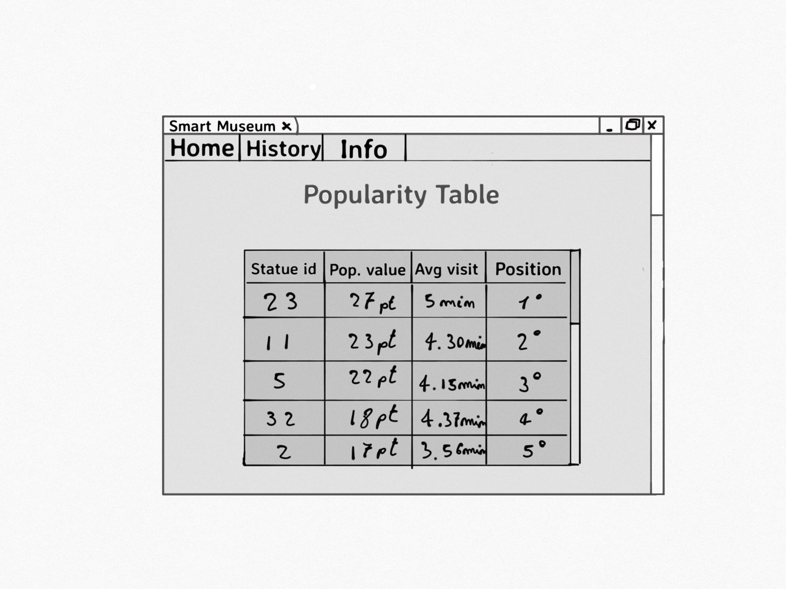
For the curator
The Output
For the curator we will create a popularity table in a web page from the values given by the proximity sensor depending on some parameters.
This will help the curator understand how to better advertise or place a certain cast.

Slide 41
Thanks！

